Slide 1
Cyclistic Bike Usage Analysis
Abu Basith
16th June 2021

Slide 2
Bike Sharing Company In Chicago
Notes:
(Scenario)
5824 Bicycles
692 stations across chicago
Bike can be unlocked from one station and returned to another
Pricing plan: single-ride passes, full-day passes or annual membership

Slide 3
Converting Casual Riders To Annual Members
Cyclistic’s finance analysts have concluded that annual members are much more profitable than casual riders.
Marketing Director wants to maximise annual memberships as he believes that this will be the key to the company’s growth. He believes that there is a good chance we can convert casual riders in to annual members
Notes:
(Scenario)

Slide 4
How do annual members and casual riders use Cyclistic bikes differently?
Notes:
(Task)
3 key areas to tackle:
1. How do annual members and casual riders use Cyclistic bikes differently?
2. Why would casual riders buy Cyclistic annual memberships?
3. How can Cyclistic use digital media to influence casual riders to become members?

Slide 5
Table of contents
01
02
03
Purpose
Analysis
Conclusion
Discuss why we we’re analysis bike data
Discuss the insight and why they are important
What can we take away from this analysis

Slide 6
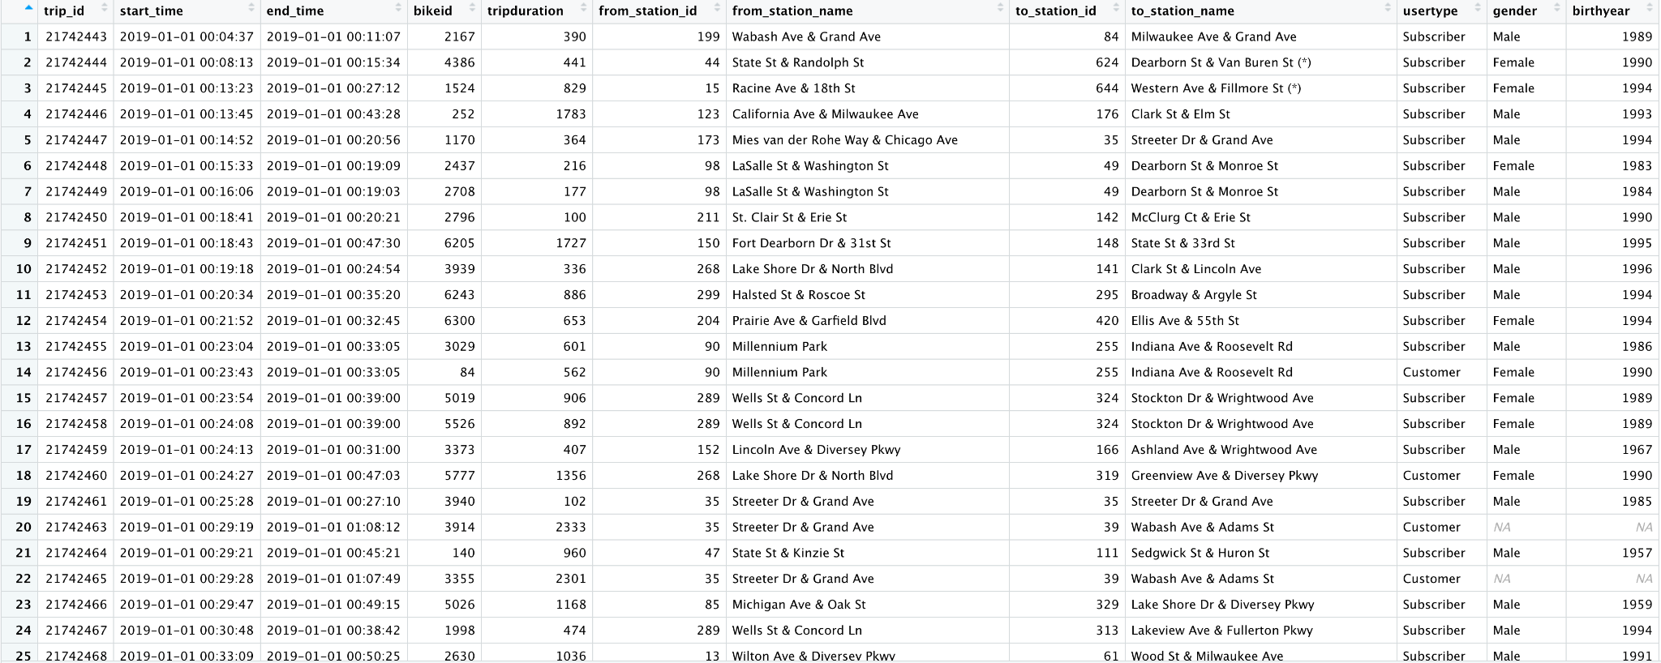
What Is Our Data?
Notes:
We looked at data from time, trip duration, age and stations from the past year
Total trips taken from this year is 3,818,004

Slide 7
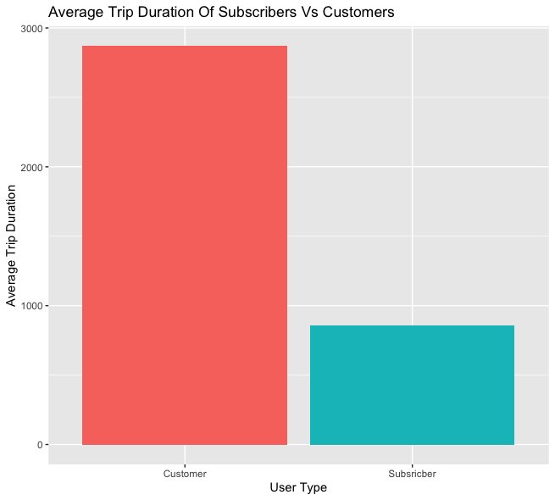
On Average Customers Use Our Bikes Longer Than Subscribers
Graph Explanation:
Trip duration is measured in seconds
Customers: 2869.257s ~ 50 mins
Subscribers: 858.4842s ~ 15 mins
What Could This Mean?
Customers are using our bikes to ride with friends
Subscribers use our bikes to get to and from work
Notes:
The longer times and one of purchases implies you need it to get somewhere one off, or your biking with friends
The shorter times and the annual payment implies that they need it more consistently but a short period of time, which falls in line with a user trying to get to work

Slide 8
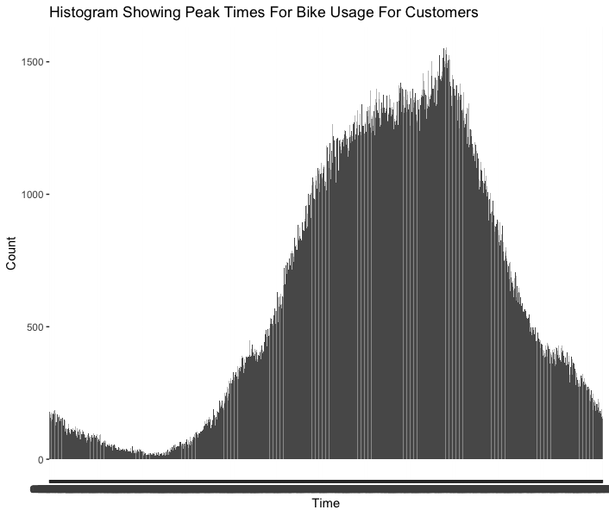
Customers Use Our Bikes Mostly In The Afternoon And Onwards
Graph Explanation:
Time is measured from 12am to 11.59pm
Count shows how many customers used a bike at that particular time
What Could This Mean?
Customers are likely to be tourists or people looking to go out
Notes:
Peak usage of our bikes is from 12pm to 6pm , which is peak business hours

Slide 9
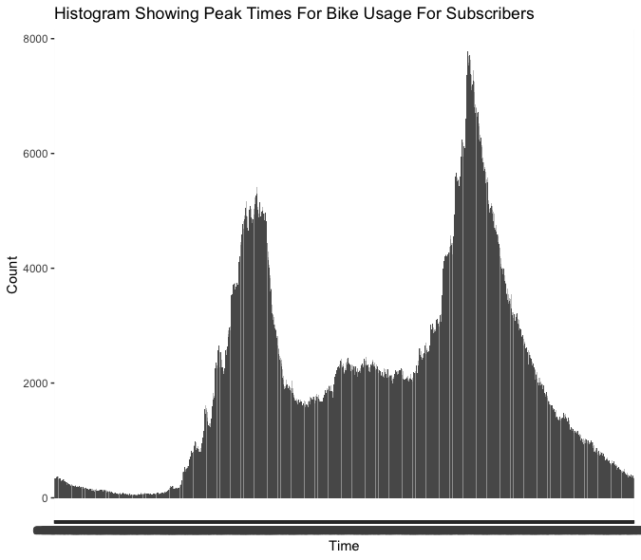
Subscribers Have 2 Peaks For Bike Usage
Graph Explanation:
Time is measured from 12am to 11.59pm
Count shows how many customers used a bike at that particular time
What Could This Mean?
Customers are likely to be office workers who use our bikes to get to and from work
Notes:
Subs use our bikes before 6pm

Slide 10
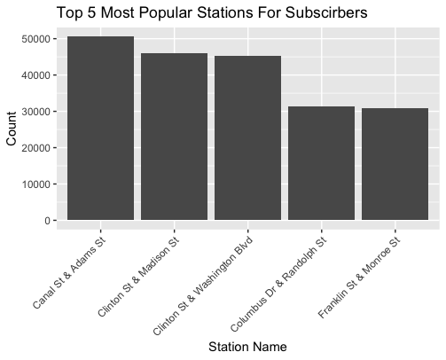
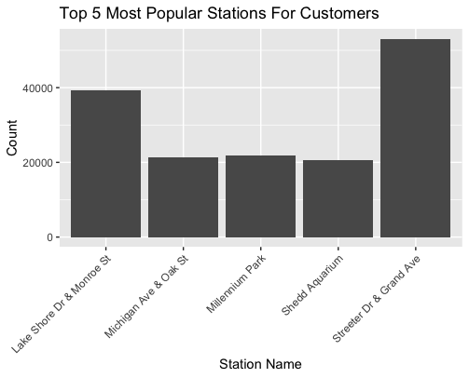
Top 5 Stations For Both Customers And Subscribers
Notes:
This Part needs more analysis:
How close are the areas next to each other?
Are there any offices next to these stations?
Map with a hot zone indicator would be useful here
2 of the locations are attractions

Slide 11
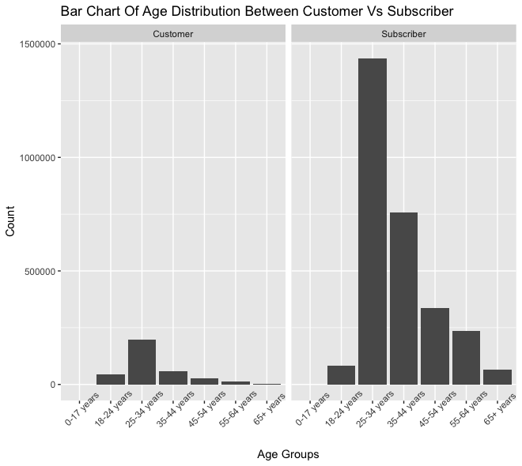
Is It Worth Trying To Convert Customers?
Notes:
Most of our users are customers already so it is not worth wasting marketing dollars to do this. Instead it would be better to focus on other efforts such as acquisiton

Slide 12
To Conclude
Casual riders are likely to be tourist or people on their day off looking for activities to do in chicago and using our bikes to get there
Annual members are likely to be office workers who use our bikes to get to and from work
Majority of our users are already annual members and it would be a waste of marketing budget if we tried to convert casual riders
Recommendation:
Marketing should focus their efforts on partnerships with attractions and offices as this is where most of our users are.
We should focus are customer acquisition campaigns that will entice user to join as an annual member
Create a custom price plan for these 2 areas

Slide 13
Thank You

